Slide 1
Probability models Uniform and Gaussian distributions

Slide 2
Uniform distribution

Slide 3



Uniform Distribution
The pdf is constant over the interval [a,b]:
CDF:
Mean and variance
f(x)
1/(b-a)
a
b
F(x)
1
a
b

Slide 4
Uniform Distribution
A digital instrument has a measurement error uniformly distributed over the interval [-0.5, 0.5]; if for example the display indicates a value equal to 10, the true value will be distributed uniformly between 9.5 and 10.5.
a) What is the expected measurement error and its variance?
d) The display of the instrument indicates 4. What is the probability that the measured quantity is 3.75? What is the probability that it is less than 3.75?

Slide 5
Uniform Distribution
A digital instrument has a measurement error uniformly distributed over the interval [-0.5,0.5]; if for example the display indicates a value equal to 10, the true value will be distributed uniformly between 9.5 and 10.5.
a) What is the expected measurement error and its variance?
X ~ U([-0.5,0.5])
μ_{X} =0; σ²_{X} = 1/12
d) FIXME The display of the instrument indicates 4. What is the probability that the measured quantity is 3.75? What is the probability that it is less than 3.75?
Y:= value of the measured quantity ~ U([3.5,4.5])
P(Y=3.75) = 0
P(Y<3.75) = (3.75-3.5)/(4.5-3.5) = 0.25

Slide 6
Normal distribution

Slide 7


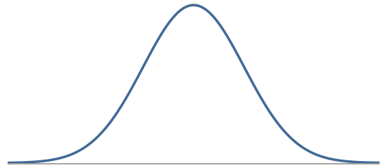
Normal Distribution
Unimodal and symmetric, bell shaped curve
Many variables are nearly normal
Denoted as N(µ, σ²) → Normal with mean µ and standard deviation σ
X~N(µ, σ²) →
Standard normal distribution
Z~N(0,1) →
µ

Slide 8
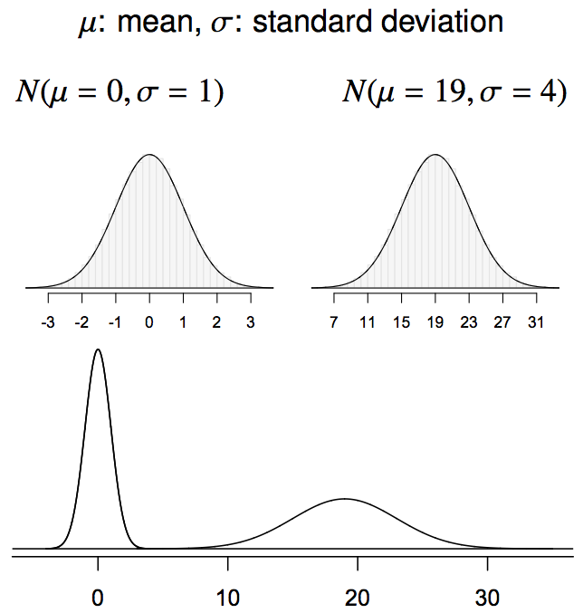
Normal distributions with different parameters
N(µ=0, σ²=1) N(µ=19, σ²=4²)

Slide 9
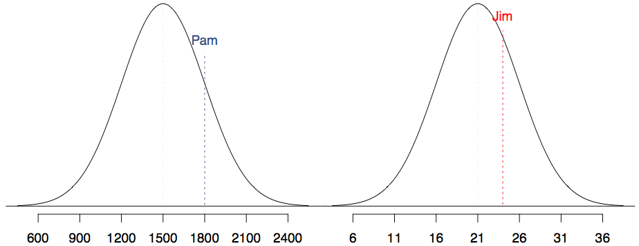
SAT scores are distributed nearly normally with mean 1500 and standard deviation 300. ACT scores are distributed nearly normally with mean 21 and standard deviation 5. A college admissions officer wants to determine which of the two applicants scored better on their standardized test with respect to the other test takers: Pam, who earned an 1800 on her SAT, or Jim, who scored a 24 on his ACT?

Slide 10
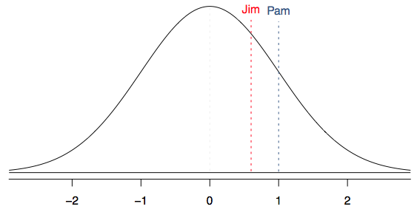
Standardizing with Z scores
Since we cannot just compare these two raw scores, we instead compare how many standard deviations beyond the mean each observation is.
Pam's score is (1800 - 1500) / 300 = 1 standard deviation above the mean.
Jim's score is (24 - 21) / 5 = 0.6 standard deviations above the mean.

Slide 11
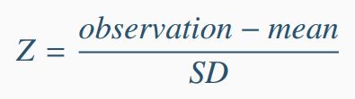
Standardizing with Z scores (cont.)
These are called standardized scores, or Z scores.
Z score of an observation is the number of standard deviations it falls above or below the mean.
Z scores are defined for distributions of any shape, but only when the distribution is normal can we use Z scores to calculate probabilities and quantiles.

Slide 12
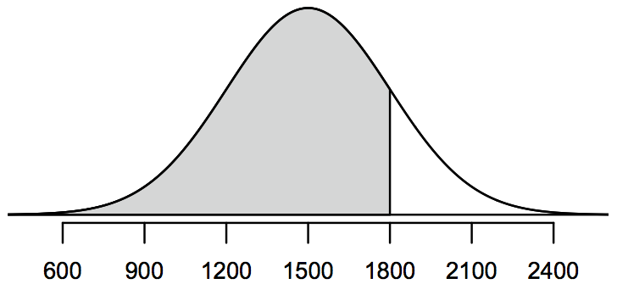
Probabilities
Probabilities, i.e. areas below the Gaussian pdf cannot be computed analytically.
The CDF F(x) = P(X≤x) is computed by Softwares
For the special case of the standard normal distribution, the CDF is usually represented by the greek letter Φ(z) = P(Z≤z) and is given in tables
P(X≤1800)

Slide 13
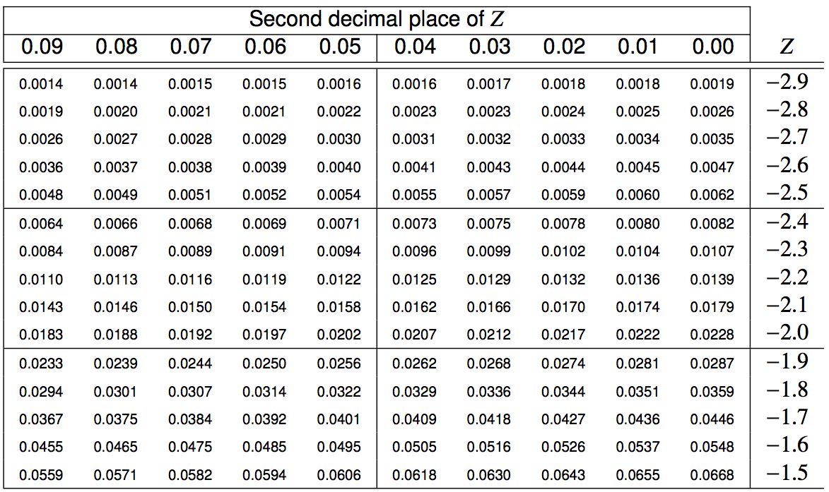
The Z table

Slide 14
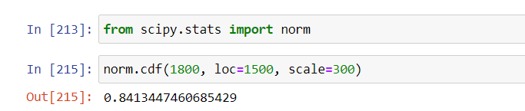
Calculating probabilities -
using Python
There are many ways to compute areas under the curve.
In Python the probability P(X≤1800) for µ=1500, σ=300 can be found using scipy.stats as follows:

Slide 15
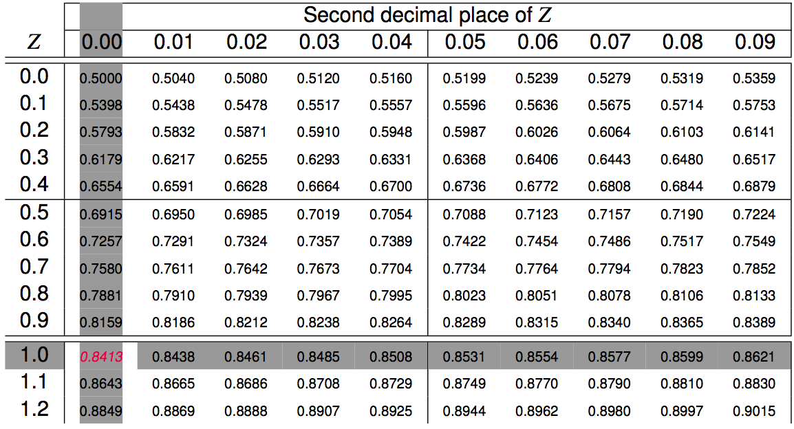
Calculating probabilities -
using tables
The standardized value of 1800 is
z = (1800 – 1500)/300 = 1
P(X≤1800) = P(z ≤1)

Slide 16
Quality control
At Heinz ketchup factory the amounts which go into bottles of ketchup are supposed to be normally distributed with mean 36 oz. and standard deviation 0.11 oz. Once every 30 minutes a bottle is selected from the production line, and its contents are noted precisely. If the amount of ketchup in the bottle is below 35.8 oz. or above 36.2 oz., then the bottle fails the quality control inspection. What percent of bottles have less than 35.8 ounces of ketchup?

Slide 17
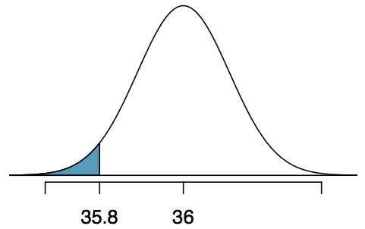
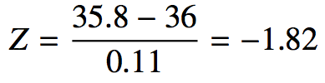
Quality control
At Heinz ketchup factory the amounts which go into bottles of ketchup are supposed to be normally distributed with mean 36 oz. and standard deviation 0.11 oz. Once every 30 minutes a bottle is selected from the production line, and its contents are noted precisely. If the amount of ketchup in the bottle is below 35.8 oz. or above 36.2 oz., then the bottle fails the quality control inspection. What percent of bottles have less than 35.8 ounces of ketchup?
Let X = amount of ketchup in a bottle: X ~ N(µ = 36, σ = 0.11)

Slide 18
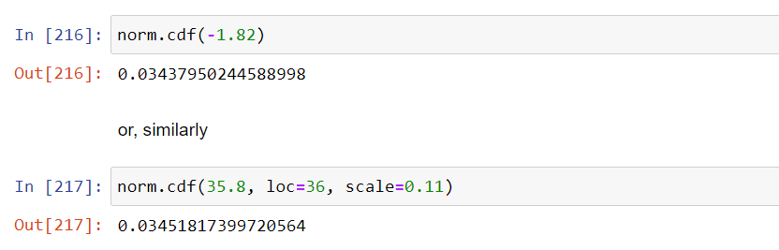
Finding the exact probability – using Python
Approximated
Exact

Slide 19
The Z table

Slide 20
Practice
What percent of bottles pass the quality control inspection?
(a) 1.82% (c) 6.88% (e) 96.56%
(b) 3.44% (d) 93.12%

Slide 21
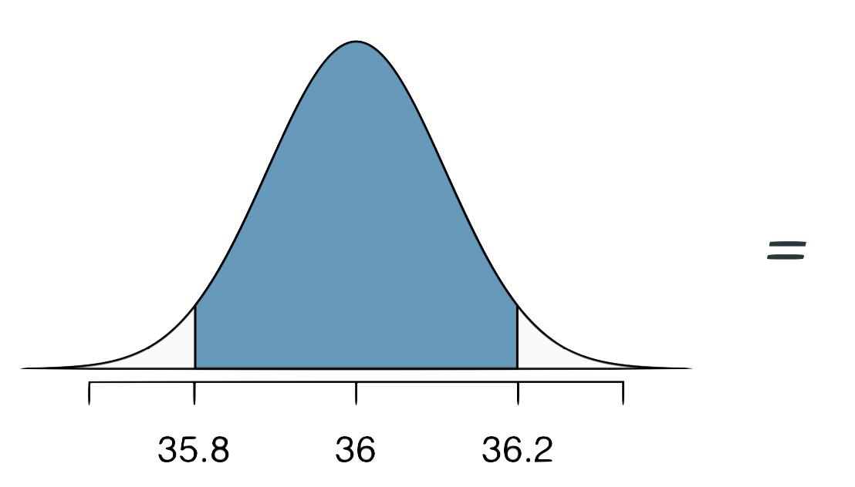
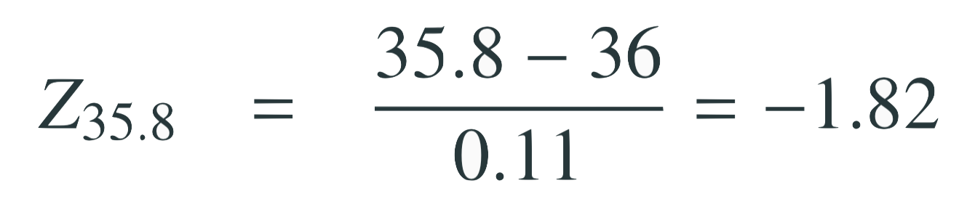
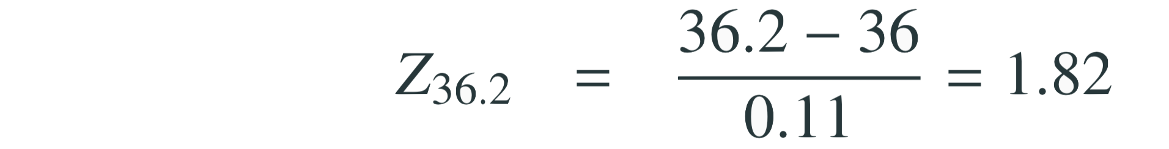
Practice
What percent of bottles pass the quality control inspection?
(a) 1.82% (c) 6.88% (e) 96.56%
(b) 3.44% (d) 93.12%
1-2*P(left tail) =1-2P(X<35.8) = 1-2*0.0344

Slide 22
Quantiles
A quantile α is the values q_{α} of X such that P(X≤q_{α}) = α.
Graphically, α is the area below the pdf to the left of q_{α}.
α
q_{α}

Slide 23
Finding quantiles
Body temperatures of healthy humans are distributed nearly normally with mean 98.2ºF and standard deviation 0.73ºF. What is the cutoff for the lowest 3% of human body temperatures?

Slide 24
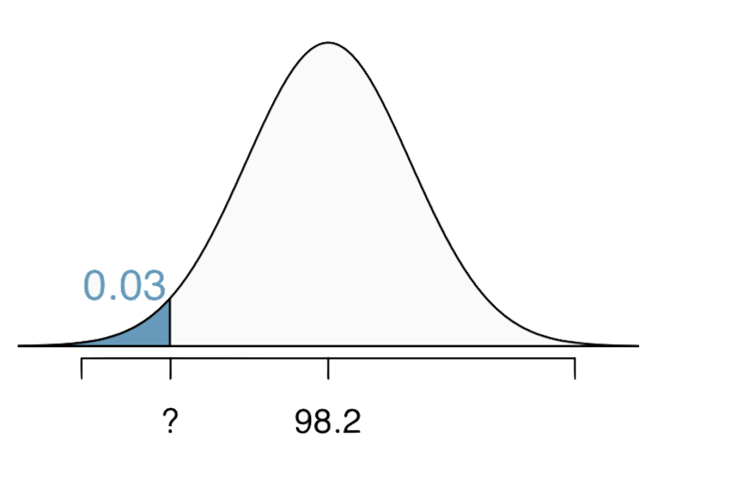

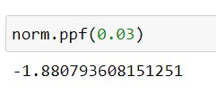
Finding quantiles
Body temperatures of healthy humans are distributed nearly normally with mean 98.2ºF and standard deviation 0.73ºF. What is the cutoff for the lowest 3% of human body temperatures?
From the table of Φ(z) or from Python we obtain
P(Z≤-1.88) = 0.03
From Python
Mackowiak, Wasserman, and Levine (1992), A Critical Appraisal of 98.6 Degrees F, the Upper Limit of the Normal Body Temperature, and Other Legacies of Carl Reinhold August Wunderlick.

Slide 25
The Z table

Slide 26
Practice
Body temperatures of healthy humans are distributed nearly normally with mean 98.2ºF and standard deviation 0.73ºF. What is the cutoff for the highest 10% of human body temperatures?
(a) 97.3ºF (c) 99.4ºF
(b) 99.1ºF (d) 99.6ºF

Slide 27
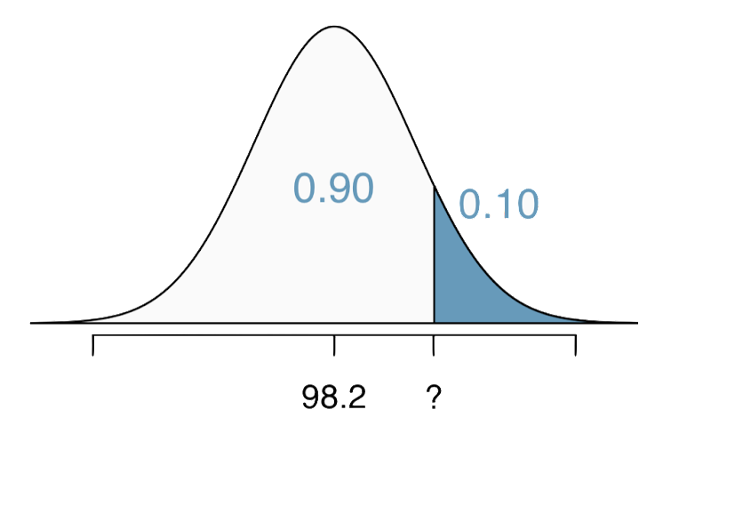
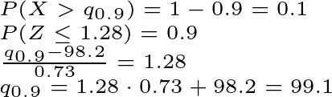
Practice
Body temperatures of healthy humans are distributed nearly normally with mean 98.2ºF and standard deviation 0.73ºF. What is the cutoff for the highest 10% of human body temperatures?
(a) 97.3ºF (c) 99.4ºF
(b) 99.1ºF (d) 99.6ºF

Slide 28
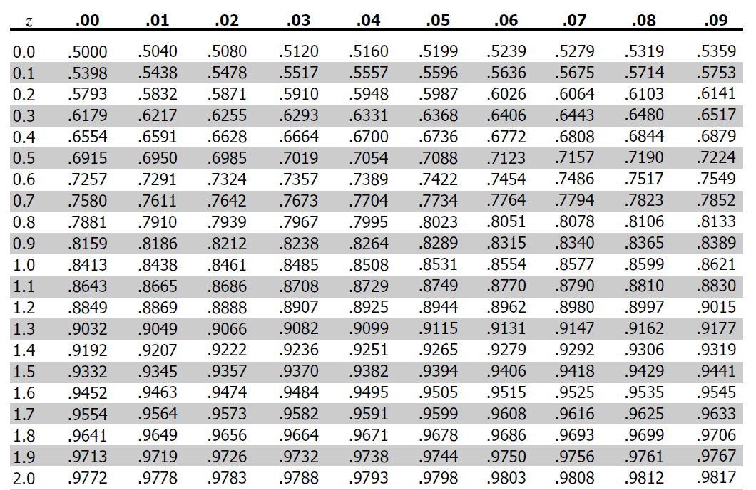
The Z table

Slide 29
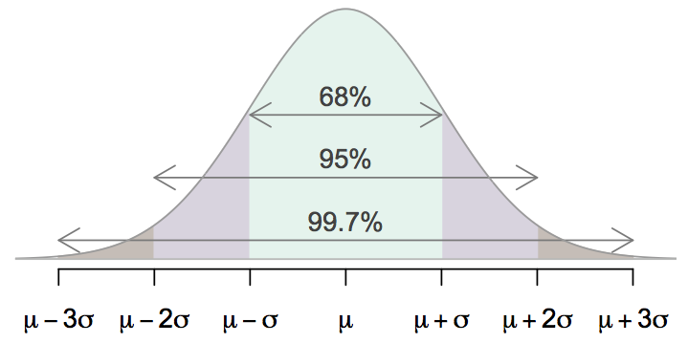
68-95-99.7 Rule
Normally distributed data,
about 68% falls within 1 SD of the mean,
about 95% falls within 2 SD of the mean,
about 99.7% falls within 3 SD of the mean.
It is possible for observations to fall 4, 5, or more standard deviations away from the mean, but these occurrences are very rare if the data are normal.

Slide 30
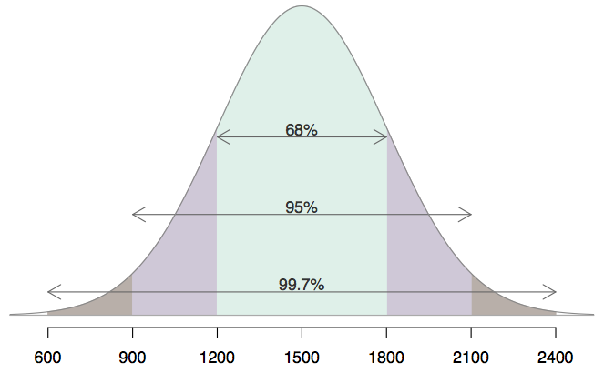
Describing variability using the 68-95-99.7 Rule
SAT scores are distributed nearly normally with mean 1500 and standard deviation 300.
~68% of students score between 1200 and 1800 on the SAT.
~95% of students score between 900 and 2100 on the SAT.
~$99.7% of students score between 600 and 2400 on the SAT.

Slide 31
Practice
Which of the following is false?
Majority of Z scores in a right skewed distribution are negative.
In skewed distributions the Z score of the mean might be different than 0.
For a normal distribution, IQR is less than 2 x SD.
Z scores are helpful for determining how unusual a data point is compared to the rest of the data in the distribution.

Slide 32
Practice
Which of the following is false?
Majority of Z scores in a right skewed distribution are negative.
In skewed distributions the Z score of the mean might be different than 0.
For a normal distribution, IQR is less than 2 x SD.
Z scores are helpful for determining how unusual a data point is compared to the rest of the data in the distribution.

Slide 33

Sum of Gaussian distributions
Let X and Y be independent, normally distributed random variables: X~N(μ_{X}, σ_{X}²) Y~N(μ_{Y}, σ_{Y}²)
Then, the random variables W = X+Y has also a normal distribution: W~N(μ_{X}+μ_{Y}, σ_{X}²+σ_{Y}²)
This result can be extended to n independent random variable which are normally distributed:

Slide 34
Sum of Gaussian distributions
Jim needs on average 20 minutes to go to work and 35 minutes to come back home due to traffic. The standard deviation for the outward journey is 5 minutes while for the return trip is 20 minutes. Assuming that the travel time has a Gaussian distribution, what is the probability that today Jim’s total travel time will be more than 1 hour? Discuss the necessary assumptions.

Slide 35
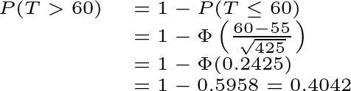
Sum of Gaussian distributions
Jum needs on average 20 minutes to go to work and 35 minutes to come back home due to traffic. The standard deviation for the outward journey is 5 minutes while for the return trip is 20 minutes. Assuming that the travel time has a Gaussian distribution, what is the probability that today Jim’s total travel time will be more than 1 hour? Discuss the necessary assumptions.
X: = outward travel time ~N(20, 5²)
Y: = return travel time ~N(35, 20²)
T = X+Y:= total travel time ~N(20+35, 5²+20²)
We have assumed that X and Y are independent. This may not be too realistic, as changes in the two travel times may have common causes, e.g., holidays, road works…

Slide 36
The Z table

Slide 37
Central limit theorem
If we consider n independent and identically distributed random variables X₁, X₂,..., X_{n} with mean μ and variance σ² the following approximations is most often a good one when n ≥ 30:
X₁+X₂+...+X_{n} ~ N(nμ, nσ²)

Slide 38
Central limit theorem
A screw manufacturer sells screws by the pound. The average weight of the screws is 21g and the standard deviation is 5g, and the kg of screws has a price of 15 euros. What is the probability that we can buy 100 screws with 30 euros?

Slide 39

Central limit theorem
A screw manufacturer sells screws by the pound. The average weight of the screws is 21g and the standard deviation is 5g, and the kg of screws has a price of 15 euros. What is the probability that we can buy 100 screws with 30 euros?
We can buy 100 screws with 30 euros when their total weight is smaller than or equal to 2000g. X_{i} := weight of the i-th screw
W = X₁+X₂ +...+X₁₀₀ := total weight
By the Central Limit Theorem, W~N(100*21; 100*25) Then,

Slide 40
Practice
A freelancer bills an average of 200 francs every day (including weekends). Her daily expenses (including both work, taxes and living related costs) are on average 150 francs per day. Both the daily income and the expenses have standard deviation of 30 francs.
Let us assume, although it is not very realistic, that the daily expenses are independent from the daily income. At the end of the year the freelance want to buy a new car. What car price will be able to afford with probability larger than 90%?

Slide 41

Practice
A freelancer bills an average of 200 francs every day (including weekends). Her daily expenses (including both work, taxes and living related costs) are on average 150 francs per day. Both the daily income and the expenses have standard deviation of 30 francs.
Let us assume, although it is not very realistic, that the daily expenses are independent from the daily income. At the end of the year the freelance want to buy a new car. What car price will be able to afford with probability larger than 90%?
By the central limit theorem
B:= yearly income ~ N(365*200,365*30²)
E:= yearly expenses ~ N(365*150,365*30²)
S = B-E:= yearly savings ~ N(365*200-365*150,365*30²+365*30²)
= N(18250, 657000)
P(S>q_{0.1}) = 1-0.1 = 0.9 →
→

Slide 42
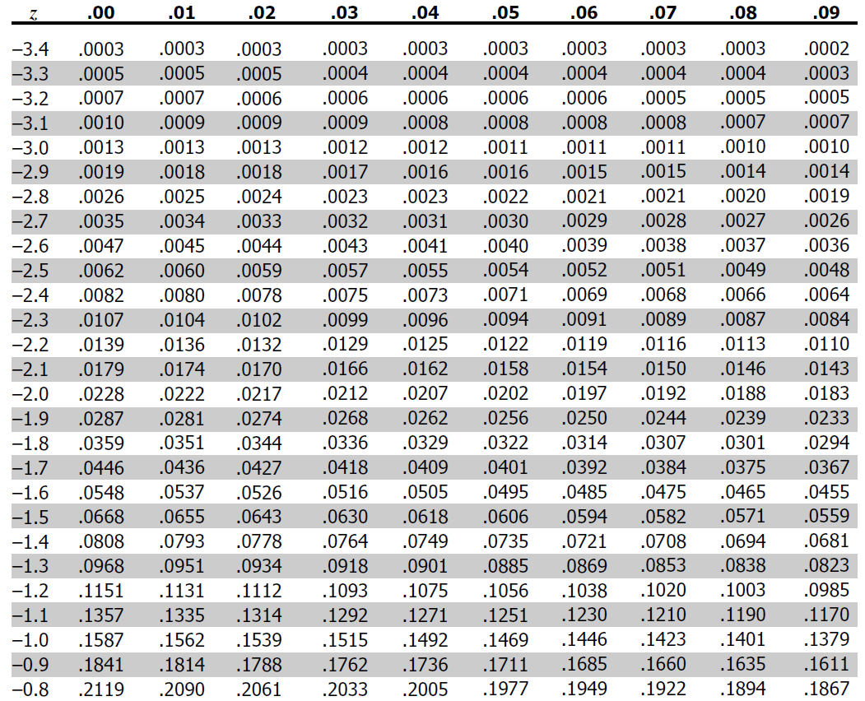
The Z table

Slide 43
Practice
A freelancer bills an average of 200 francs every day (including weekends). Her daily expenses (including both work, taxes and living related costs) are on average 150 francs per day. Both the daily income and the expenses have standard deviation of 30 francs.
Each 1st of January the freelance compute the average daily income over the past year. What is the probability that such value is smaller than 150 francs?

Slide 44


Practice
A freelancer bills an average of 200 francs every day (including weekends). Her daily expenses (including both work, taxes and living related costs) are on average 150 francs per day. Both the daily income and the expenses have standard deviation of 30 francs.
Each 1st of January the freelance compute the average daily income over the past year. What is the probability that such value is smaller than 150 francs?

Slide 45
Practice
A freelancer bills an average of 200 francs every day (including weekends). Her daily expenses (including both work, taxes and living related costs) are on average 150 francs per day. Both the daily income and the expenses have standard deviation of 30 francs.
Assuming that the daily income has a Gaussian distribution, what is the probability that the income of one day is smaller than 150 francs?

Slide 46
Practice
A freelancer bills an average of 200 francs every day (including weekends). Her daily expenses (including both work, taxes and living related costs) are on average 150 francs per day. Both the daily income and the expenses have standard deviation of 30 francs.
Assuming that the daily income has a Gaussian distribution, what is the probability that the income of one day is smaller than 150 francs?
B ~ N(200, 30²)
Notice that there is almost 5% probability that the daily income falls below 150 francs, while the probability of the average daily income over one year falling below 150 francs is zero. This is due to the much larger variability (σ=30) of the daily income compared to its average over one year (σ=30/√365).

Slide 47
The Z table

